Slide 1


WELCOME TO THE NATIONAL HISTORY SCHOLAR SOCIETY / HISTORY CLUB!

Slide 2

NATIONAL HISTORY SCHOLAR SOCIETY/HISTORY CLUB REQUIREMENTS:
- 5 hours of tutoring completed by March 31st (juniors and seniors + select sophomores)
- 3.0 or higher in all history classes
- Money for chords is T.B.D
- Dues are $10 for all members

Slide 3
NATIONAL HISTORY SCHOLAR SOCIETY REQUIREMENTS FOR CURRENT SENIORS:
- 2+ years in National History Club (seniors can be inducted to NHSS this year and juniors can be inducted at the end of this year)
- Teacher recommendation
- B or better in at least 1 AP history course
- Essay

Slide 4

NATIONAL HISTORY SCHOLAR SOCIETY REQUIREMENTS FOR JUNIORS:
- 5 hours of service by the end of the school year
- Commit to at least 5 hours next year
- Teacher recommendation
- B or better in at least 1 AP history class

Slide 5

TUTORING:
- Tutoring: Every Tuesday in Mrs. Walters room, 3032 and every Thursday in Mrs. Trerotola’s room, 3040
-Must be able to tutor without teacher assistance!
-Requirement to get chord
-5 hours of tutoring per member of scholar society by March 31st

Slide 6

VOLUNTEERING ACTIVITIES:
-Volunteering: VFW centers , museums, operation gratitude, DAV volunteering
- Activities: black history month , presidents' day , veteran's day , update history bulletin boards, history bowl, history podcast, guest speakers, field trips, oral history interviews, story corps, add to blog, history reviews, sol help

Slide 7

OPPORTUNITIES:
- Could get published in Concord Review for history paper
- History student of the year award
Lessons of leadership contest: $5000 prize to club members who write the best essay or create the best website/documentary on a historical figure and his/her leadership through a time of crisis
DAV volunteer scholarships

Slide 8


OFFICERS for 2020-2021 Schoolyear:
President: Maisha Farzana
Vice President: Rhea Wanchoo
Treasurer: Maya Pokhrel
Historian/ Public accounts: Sumina Chapagai

Slide 9
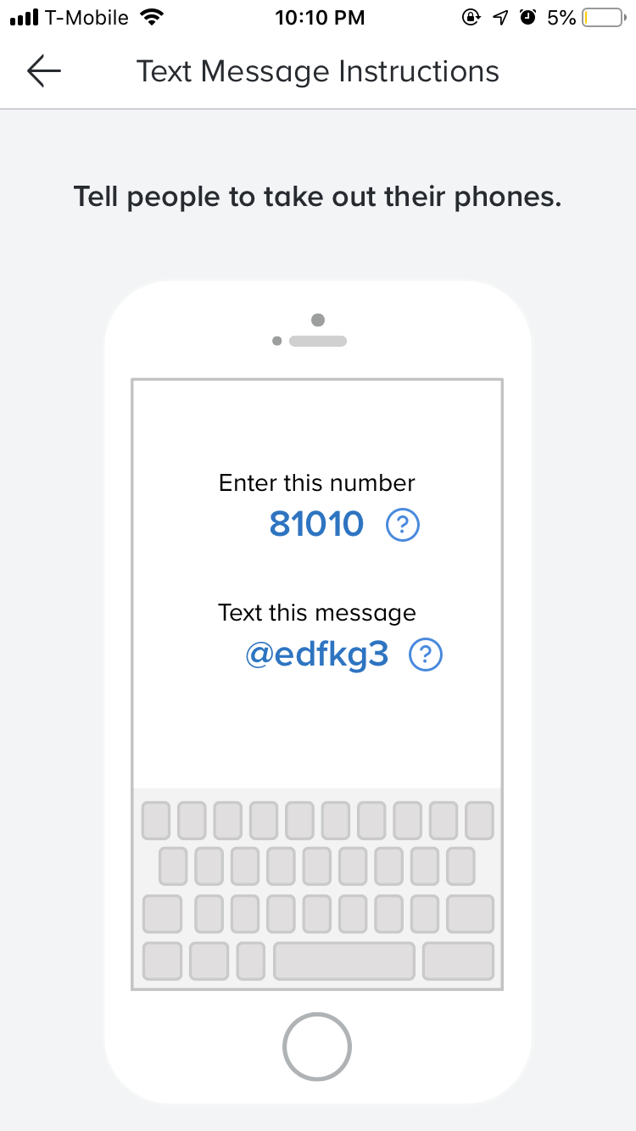
JOIN OUR REMIND!!!

